Slide 1

Working title: CFD and ROM of Flow over a Golf Court
Bachelor project, 2026
Meeting 3, date: 25-03-2026
GROUP 3
Eske Freiesleben
Jacob Manniche
J. Alfred Pedersen
Student ID
S234229
S234258
S230869

Slide 2
Table of contents
General progress and theory
3-4: We looked into the stability term for the 2D logarithmic wind profile
5-6: We investigated how flow over a Gaussian hill can be approximated (again 2D using logarithmic profile)
7: We found a data-slice for a RANS simulation over a Gaussian hill, and to understand the data structure and how to visualize it, we plotted the velocity and turbulence intensity over the hill
Structure and Gantt-diagram
8-9: Structure update including our estimate of a step-by-step approach and updated GANTT diagram
Non-disclosure agreement
10: Update on the NDA
Gbar update
11: Status on Gbar
Bachelor project:
CFD and ROM of Flow over a Golf Court

Slide 3
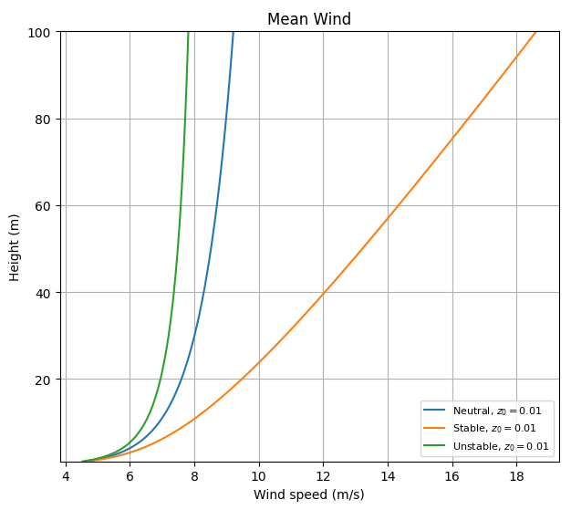
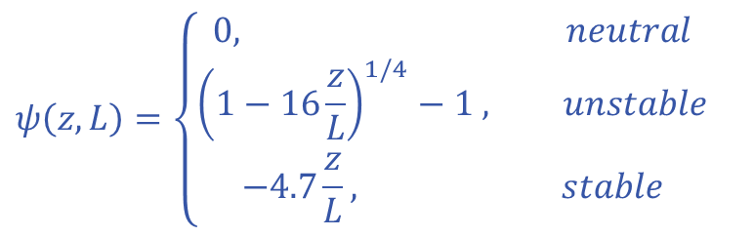


Stability (1/2)
For the vertical mean wind speed profile U(z), we looked into the stability term $ψ$
To see the impact of stability on the profile, here we found the following definition:
From Troen, I., & Lundtang Petersen, E. (1989). European Wind Atlas. Risø National Laboratory
$$U\left(z\right)=\frac{u^{∗}}{κ}∙ln⁡\left(\frac{z}{z_{0}}−ψ(z,L)\right)$$
$$ψ\left(z,L\right)=\left\{\begin{aligned}0, neutral \\ {\left(1−16\frac{z}{L}\right)}^{1/4}−1 , unstable \\ −4.7\frac{z}{L}, stable\end{aligned}\right.$$
Bachelor project:
CFD and ROM of Flow over a Golf Court

Slide 4
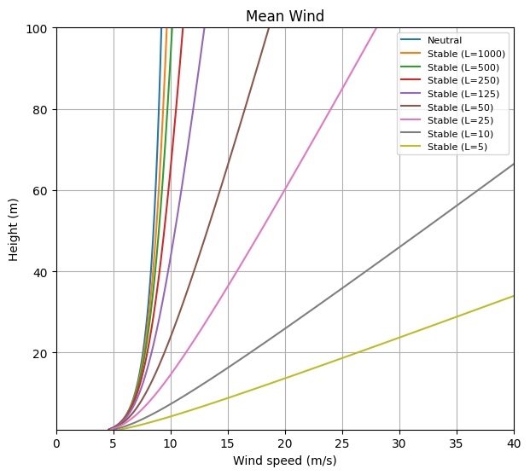
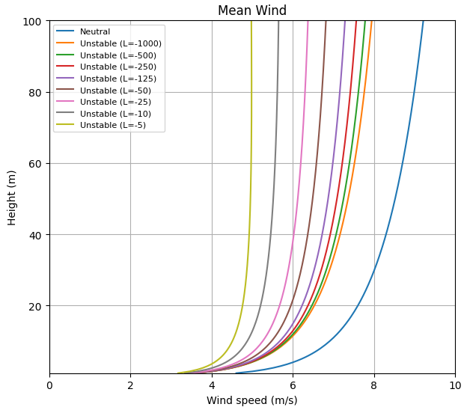
Stability (2/2)
Following this we looked into the Monin-Obukhov length L in the stability term to see its impact. And we see how larger values of L both negative and positive approach the neutral profile.
We are still looking into estimating L and how this relates to lapse rate and the diurnal cycle
Bachelor project:
CFD and ROM of Flow over a Golf Court

Slide 5
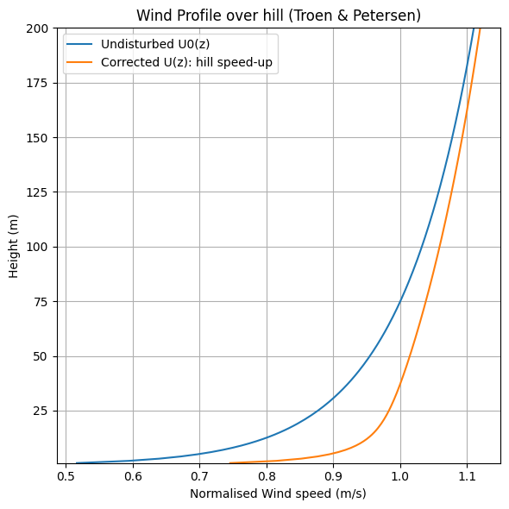
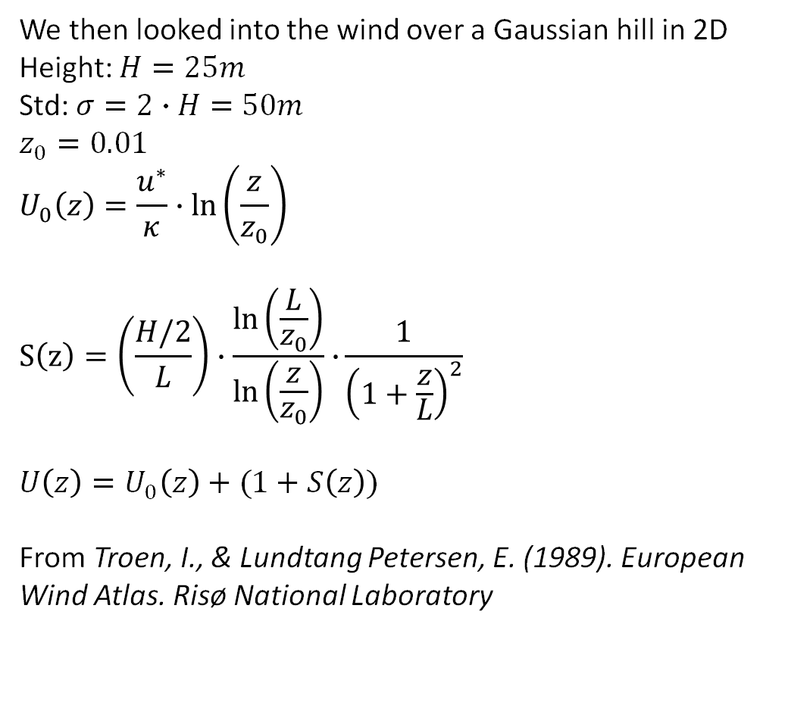
Wind over Gaussian hill in 2D (1/2)
We then looked into the wind over a Gaussian hill in 2D
Height: $H=25m$
Std: $σ=2∙H=50m$
$$z_{0}=0.01$$
$$U_{0}\left(z\right)=\frac{u^{∗}}{κ}∙ln⁡\left(\frac{z}{z_{0}}\right)$$
$$S\left(z\right)=\left(\frac{H/2}{L}\right)∙\frac{ln⁡\left(\frac{L}{z_{0}}\right)}{ln⁡\left(\frac{z}{z_{0}}\right)}∙⁡\frac{1}{{\left(1+\frac{z}{L}\right)}^{2}}$$
$$U\left(z\right)=U_{0}\left(z\right)+(1+S\left(z\right))$$
From Troen, I., & Lundtang Petersen, E. (1989). European Wind Atlas. Risø National Laboratory
Bachelor project:
CFD and ROM of Flow over a Golf Court

Slide 6
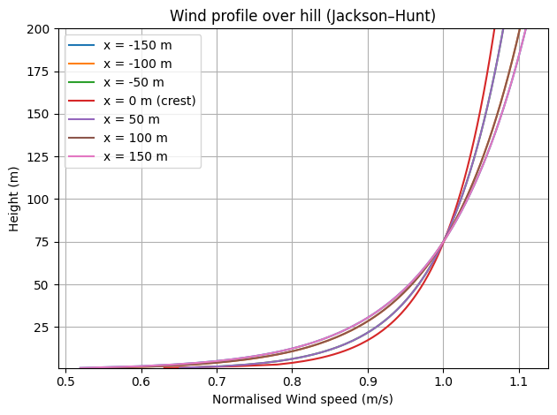
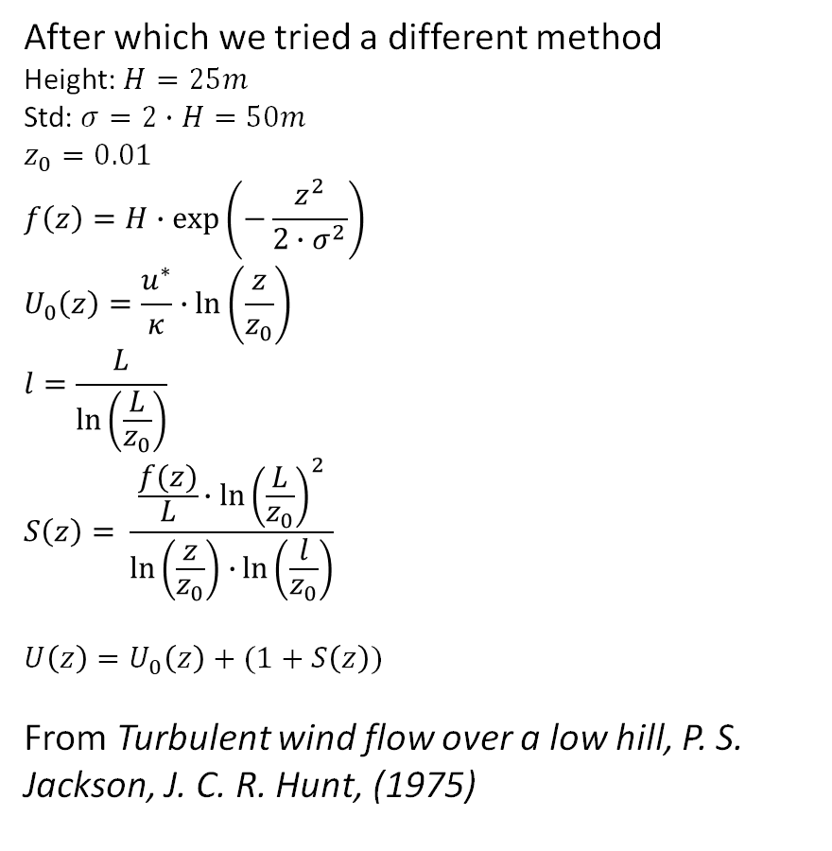
Wind over Gaussian hill in 2D (2/2)
After which we tried a different method
Height: $H=25m$
Std: $σ=2∙H=50m$
$$z_{0}=0.01$$
$$f\left(z\right)=H∙\exp\left(−\frac{z^{2}}{2∙σ^{2}}\right)$$
$$U_{0}\left(z\right)=\frac{u^{∗}}{κ}∙ln⁡\left(\frac{z}{z_{0}}\right)$$
$$l=\frac{L}{\ln\left(\frac{L}{z_{0}}\right)}$$
$$S\left(z\right)=⁡\frac{\frac{f(z)}{L}{∙ln\left(\frac{L}{z_{0}}\right)}^{2}}{\ln\left(\frac{z}{z_{0}}\right)∙\ln\left(\frac{l}{z_{0}}\right)}$$
$$U\left(z\right)=U_{0}\left(z\right)+(1+S\left(z\right))$$
From Turbulent wind flow over a low hill, P. S. Jackson, J. C. R. Hunt, (1975)
Bachelor project:
CFD and ROM of Flow over a Golf Court

Slide 7
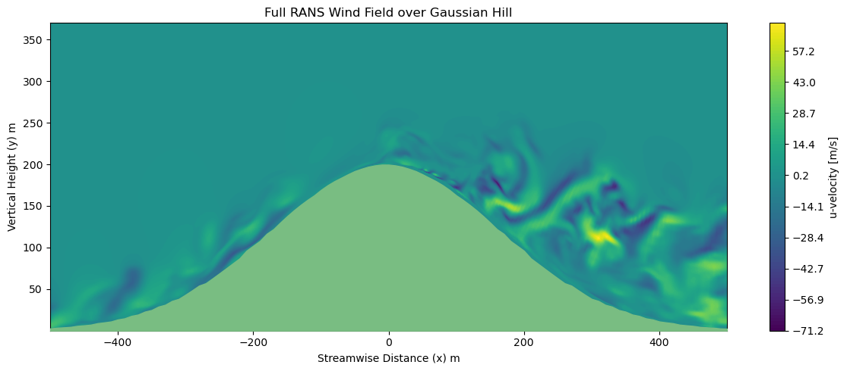
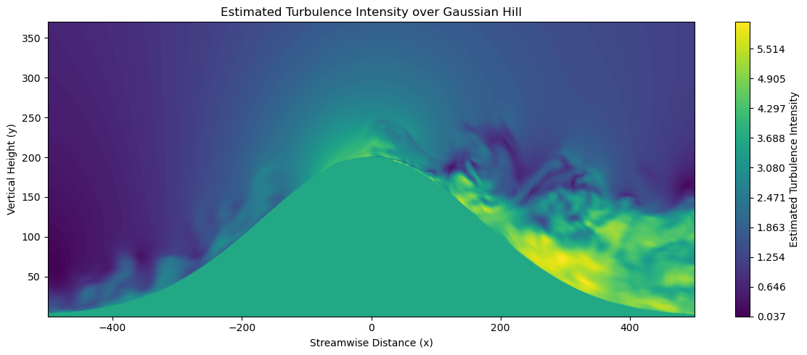
RANS simulation over Gaussian hill
Looking around on data.dt.dk, we found a RANS simulation from:
Flow field over a Gaussian hill by RANS simulation,
Ju Feng & Wen Zhong Shen (2018)
Streamwise velocity
From this data set we then extracted a slice and visualized (in python) the velocity over the hill.
Turbulence Intensity
We then tried to make a turbulence intensity plot from the data
Bachelor project:
CFD and ROM of Flow over a Golf Court

Slide 8
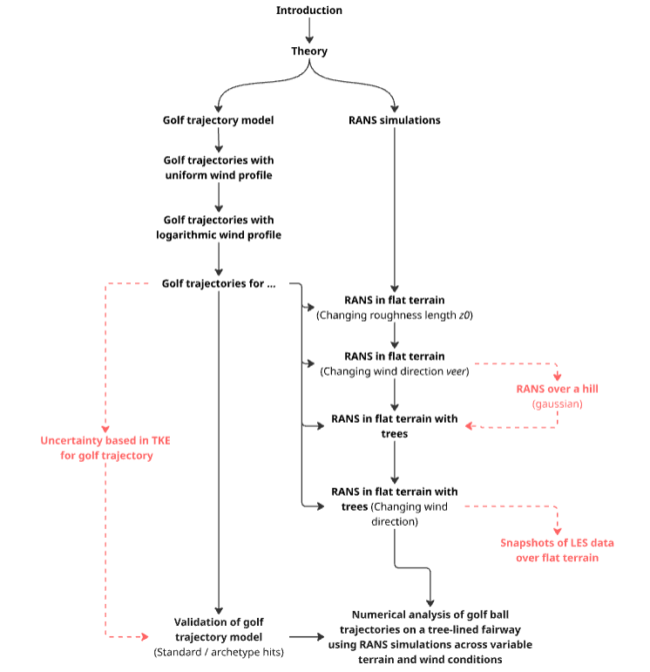
Structure update (1/2)
Following our last meeting, we have updated the general structure for the project, as can be seen here on the right:
We have also distributed the initial task of who deals with setting up RANS and who deals with the trajectory model:
RANS: Jacob, Alfred
Trajectory model: Eske
Note: Red components in the project structure are either undetermined in placement or because we don’t know if they are in-scope yet.
Bachelor project:
CFD and ROM of Flow over a Golf Court

Slide 9
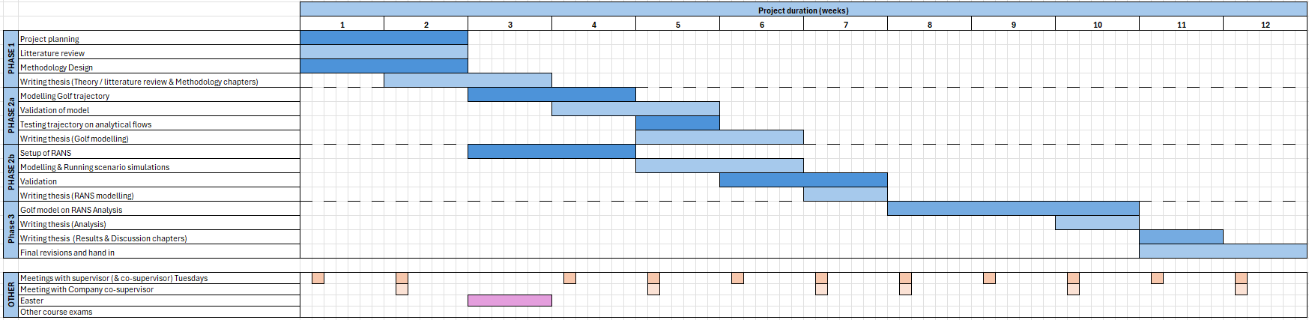
Structure update (2/2)
And as a natural continuation on the structure update, we also updated the GANTT-diagram to reflect the new direction and this two-pronged approach with RANS and trajectory model
Bachelor project:
CFD and ROM of Flow over a Golf Court

Slide 10
NDA
We have in our group talked it through and have agreed to sign the NDA, this will of course be done as soon (Hopefully before the meeting on 7/4) as possible and sent over to Trackman
Information we need to properly sign;
Exact project title
The working title for the project is: CFD and ROM of Flow over a Golf Court, but this title does not necessarily reflect the current direction of the project, so this needs to be updated.
Exact collaboration period
The exact period of the project should be 16.03.2026 – 08.07.2026, twelve weeks total from the start date.
Bachelor project:
CFD and ROM of Flow over a Golf Court

Slide 11
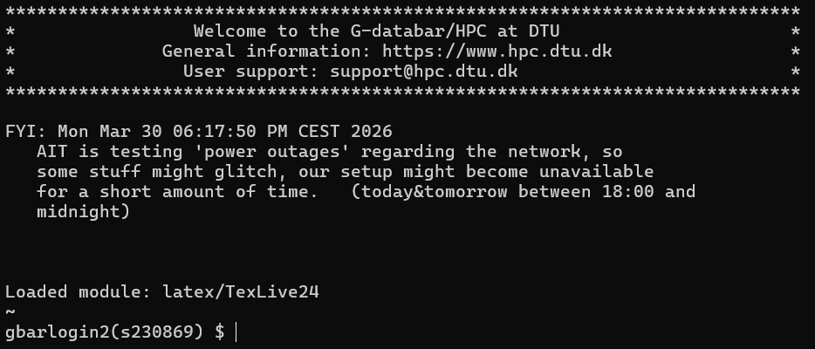
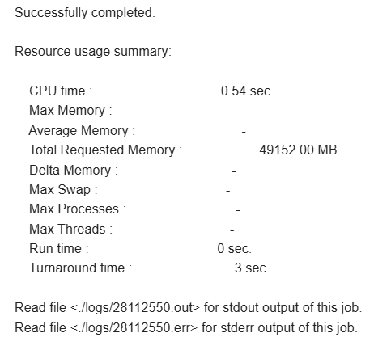
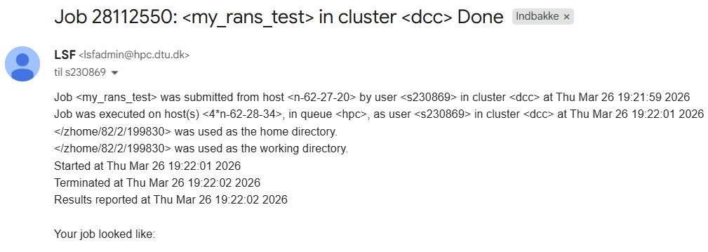
G-bar/HPC update
Welcome message for the G-bar/HPC in Powershell
We have followed the guide found on PyWakeEllipSys and we can now log on to gbar, where we can upload and queue a simple job, which just initializes some packages and sends an email once its done. This currently works without issues.
For next steps, we need to learn best practices setting up a larger simulation, before we commit to send a larger task, as to not mess something up for ourselves or other users.
Snippet from email telling us that the job was successful
and specifying output location as /logs/
Bachelor project:
CFD and ROM of Flow over a Golf Court

